Slide 1



Impact of War and other Parameters on Life Expectancy over Time in African Countries
Manu Gupta, David Williams, Daniel DiNicola
“I can prove anything by statistics except the truth.”
- George Canning

Slide 2
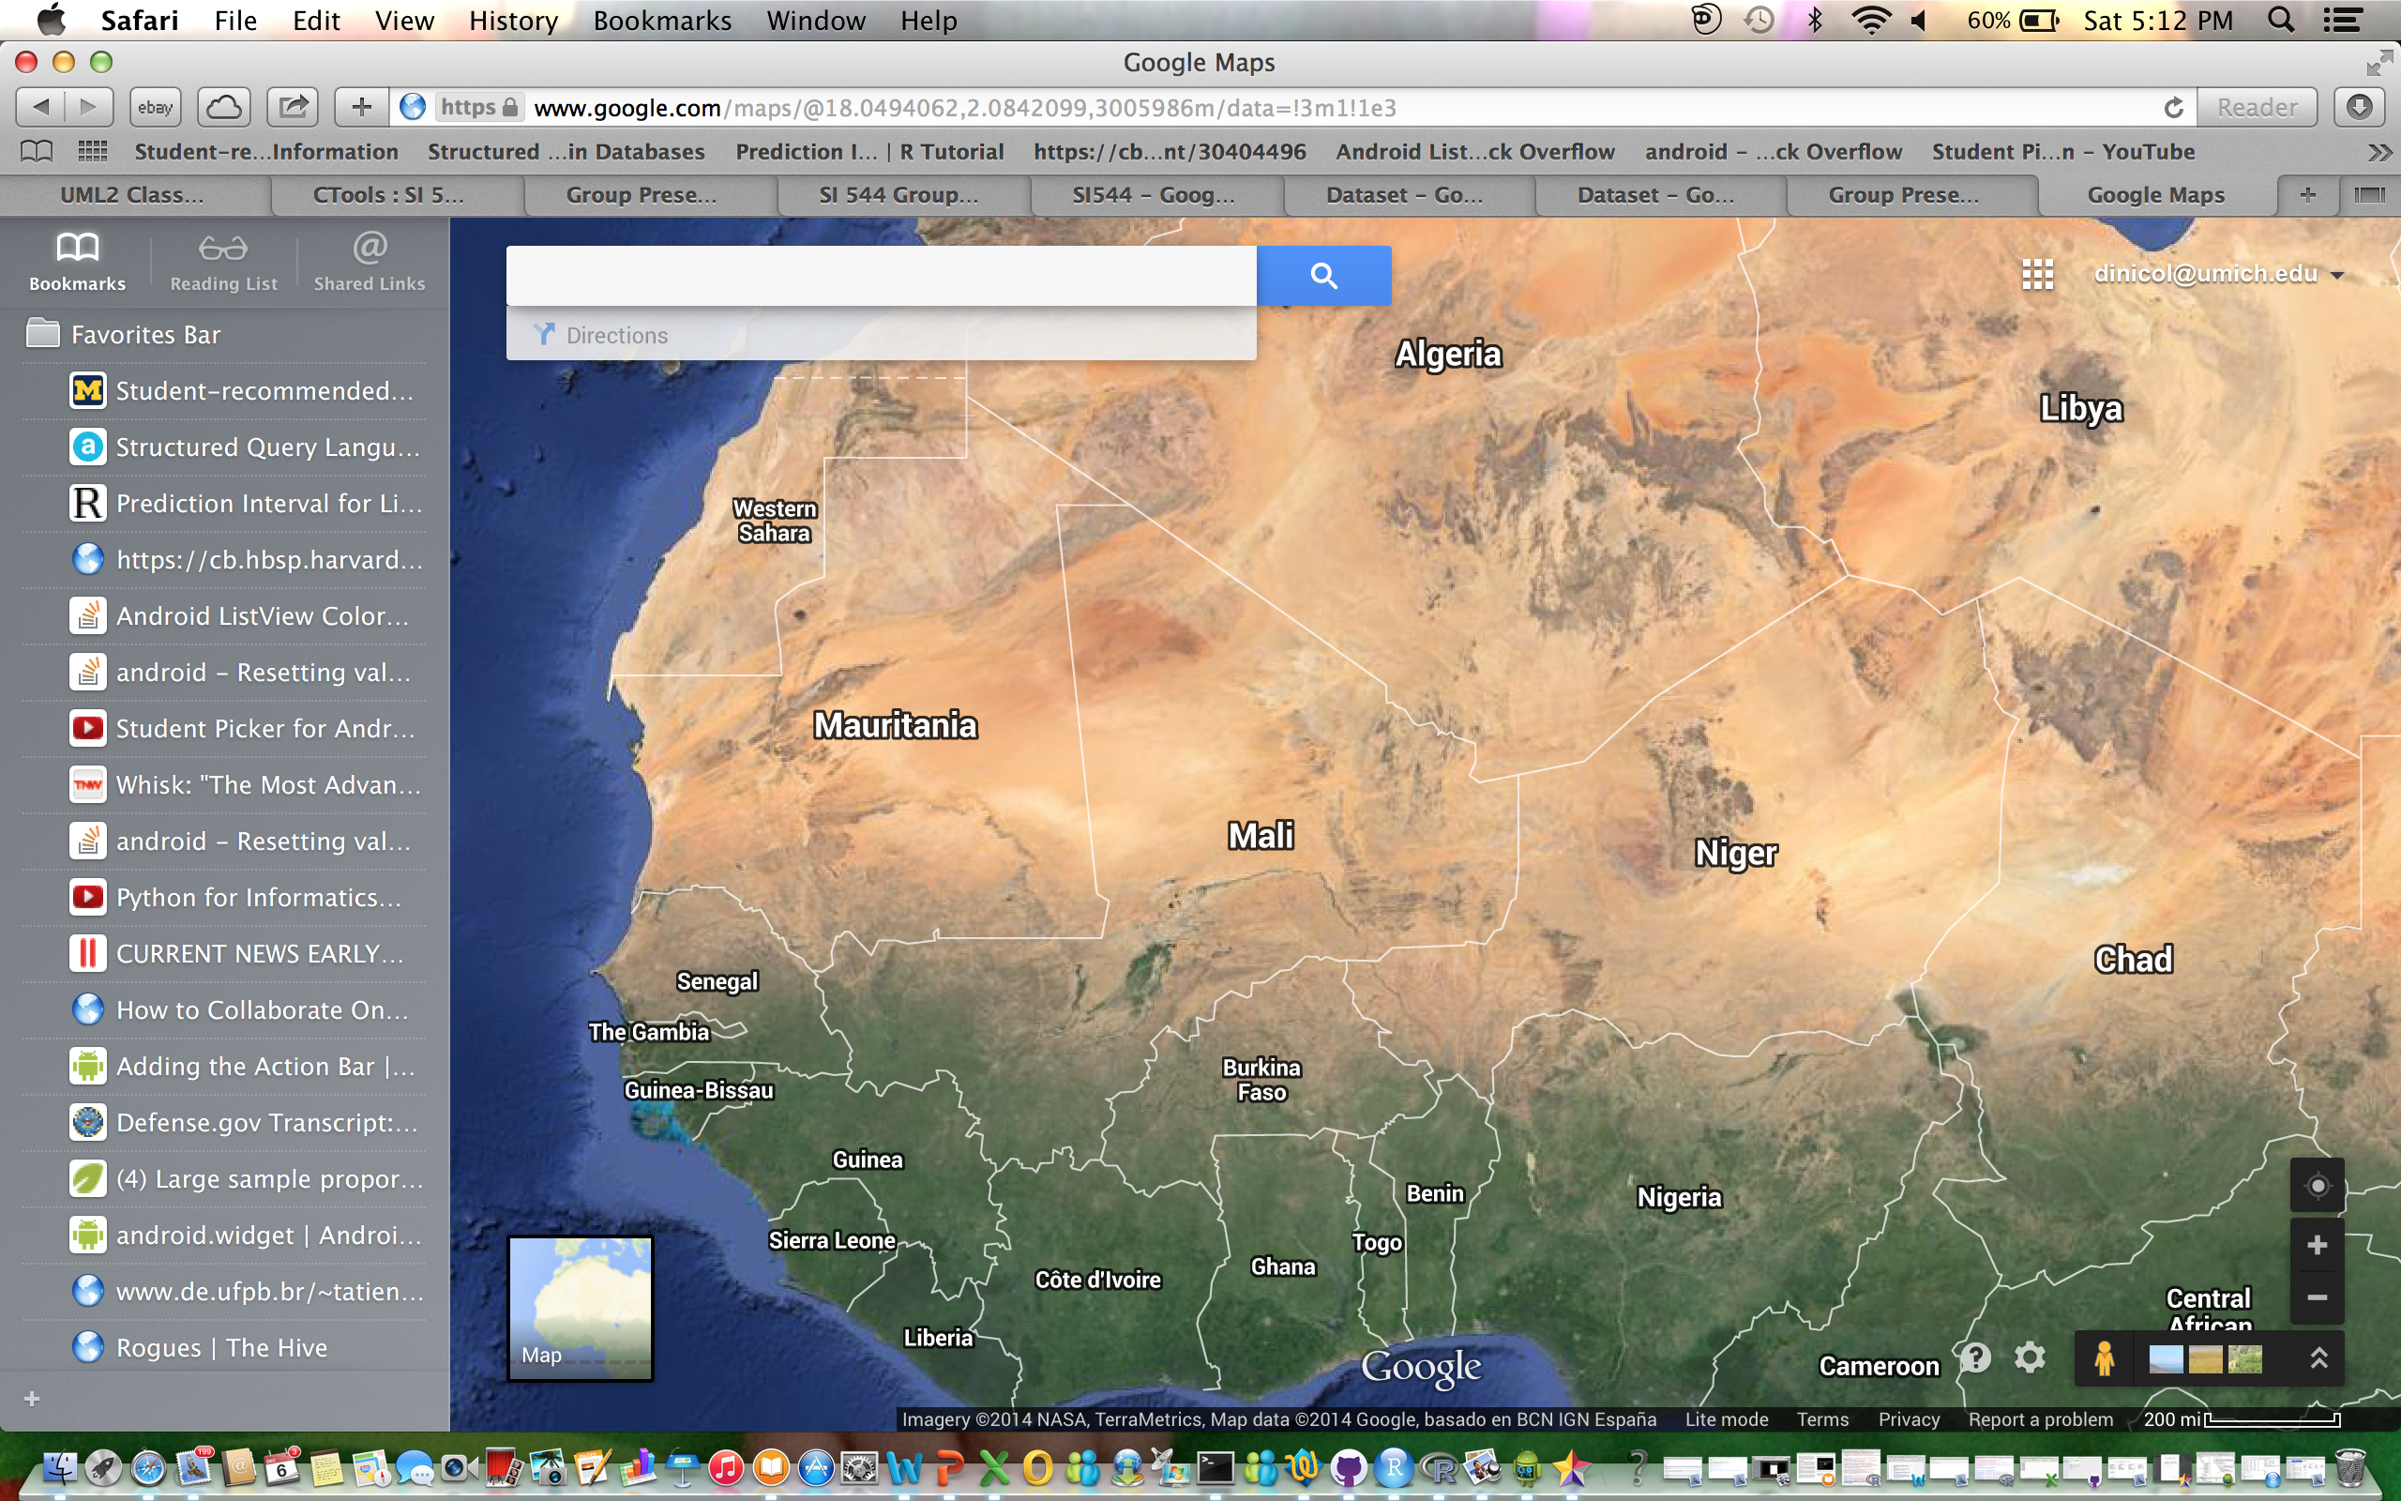
Background
Motivation: Interested in portions of Africa recently in the news. Ebola is too new. War, health expenditure of each government, access to clean water, and other items related to life expectancy made for interesting analysis.
Data Source: Quandl.com
(World Bank cross country data)
Countries: Sierra Leone, Senegal,
and Chad.
Abstract: Each country has experienced
some level of conflict within the last 30 years. Analysis will focus on the period of 1990-2012.

Slide 3
Methods Used
Regression Model for Each Country: Sierra Leone: csv.lm = lm(Life.Expectancy~War+Health.Expenditure+I(Improved.Water.Sources*Improved.Sanitation)+Percentage.of.People.Undernourished, data=csv)
Note: War serves as a dummy variable. For dates when a country is at war, the value of war is 1. For dates when a country is not at war, the value of war is 0.
Paste a regression for Sierra Leone, and plot Life expectancy vs. Health Expenditure and /or Life expectancy vs. War…
Regress Sierra Leone with % undernourished along with other variables, then re-run after removing % undernourished…

Slide 4
Findings / Talking Points
Health Expenditure: Chad, Senegal, Sierra Leone
Combining Access to Improved Water Sources / Sanitation.
These two variables were closely related.
Senegal findings are consistent with predictions / expectations
Interestingly, Chad’s largest investments in health expenditure came during times at war. Has decreased since, while life expectancy has increase

Slide 5
Conclusion

